Slide 1
Housing Price Prediction
Connor Mignone
Tonnar Castellano
Ty Painter

Slide 2
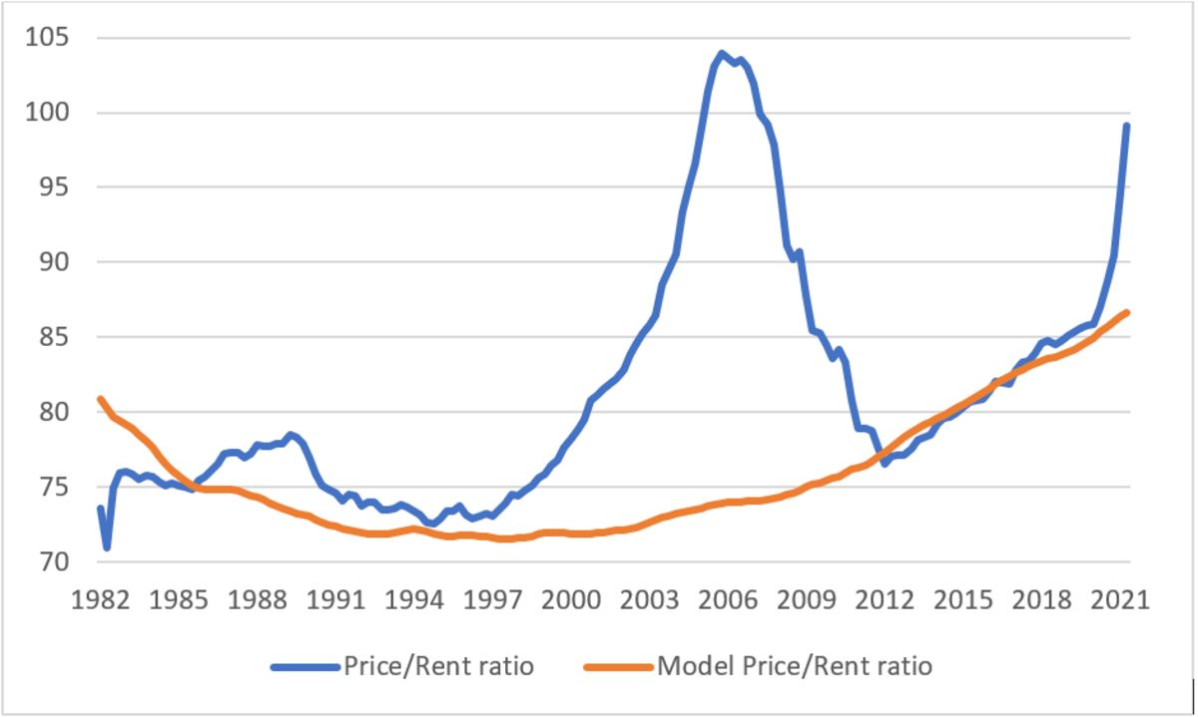
Motivation
Highly profitable market
Housing market currently skyrocketing
Corporations looking to move into the space
Credit: https://www.bloomberg.com/opinion/articles/2022-04-05/the-housing-market-is-hot-but-certainly-not-unhinged

Slide 3

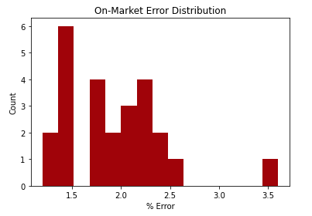
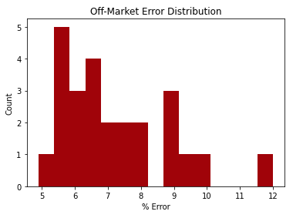
Challenges
Ever changing market
Detailed data is highly coveted
Very difficult modeling
Continuous Failed Attempts

Slide 4
Problem
Metropolitan Area | Median Error | Within 5% of Sale Price
Atlanta, GA | 7.2% | 38.3%
Baltimore, MD | 6.7% | 40.2%
Boston, MA | 7.4% | 35.9%
Charlotte, NC | 6.7% | 40.6%
Chicago, IL | 8.1% | 34.3%
Cincinnati, OH | 8.7% | 32.3%
Cleveland, OH | 10.0% | 29.0%
Seattle, WA | 6.4% | 41.6%
Analyze the housing market in the Pacific Northwest
Find where model is making poor predictions
Find any arbitrage opportunities
Compare our model to Zillow’s
Computed on AWS

Slide 5
Data
Columns
Numeric | Categorical
Price (y-var) Bedrooms Bathrooms SqFt Living SqFt Lot Floors Waterfront View Condition SqFt above SqFt basement Year Build Year Renovated | Street City Zip Code Country
Metrics
515 KB
4600 Rows
18 Columns
Pacific Northwest - Seattle Metropolitan Area

Slide 6
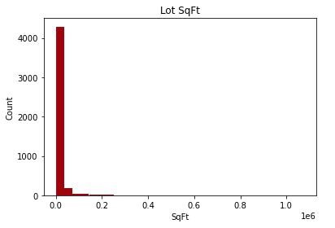
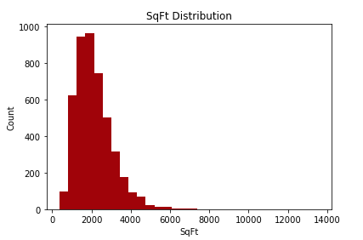
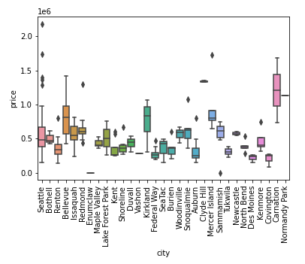
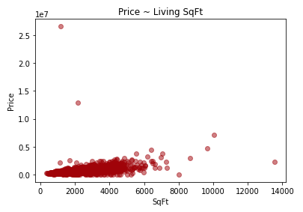
Exploratory Data Analysis

Slide 7
Data Cleaning
Prices | Count of price
$0 | 49
$300000 | 42
$400000 | 31
Data Cleaning:
Look through the data to ensure usability
Removing prices with zero
Checking rows with duplicate addresses
Addresses | Count of Addresses
2520 Mulberry Walk NE | 4
2500 Mulberry Walk NE | 3
8434 W Mercer Way | 2
Bedrooms | Count of bedrooms
0 | 2
1 | 38

Slide 8
Methods
Feature Engineering PySpark Pipeline:
Tokenize and HashingTF on Street Names
One Hot on Encoding Cities and Zip Codes

Slide 9
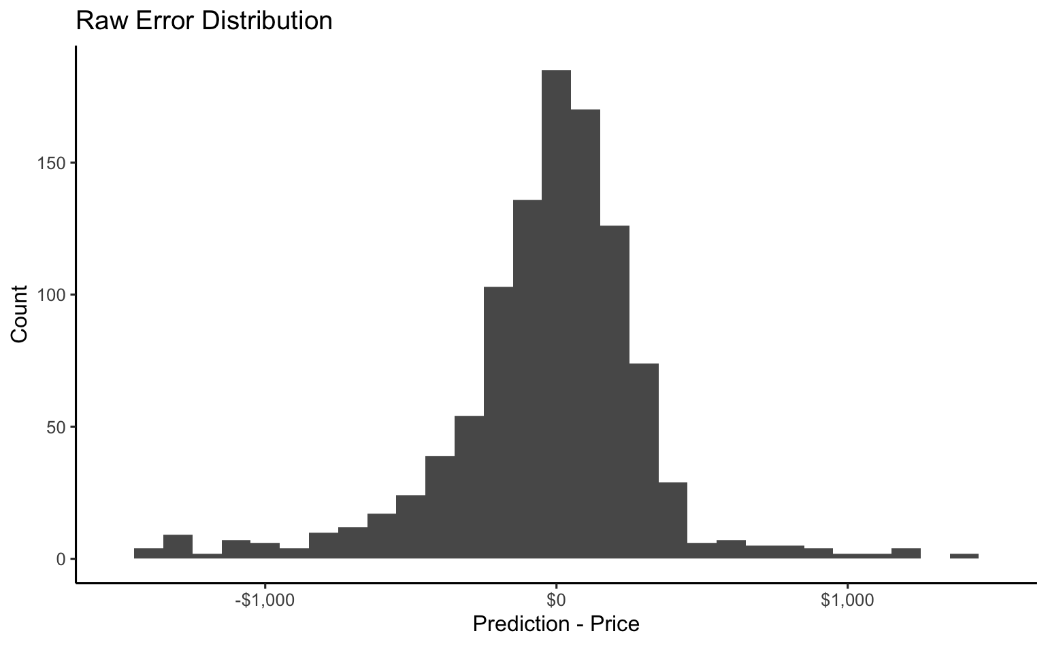
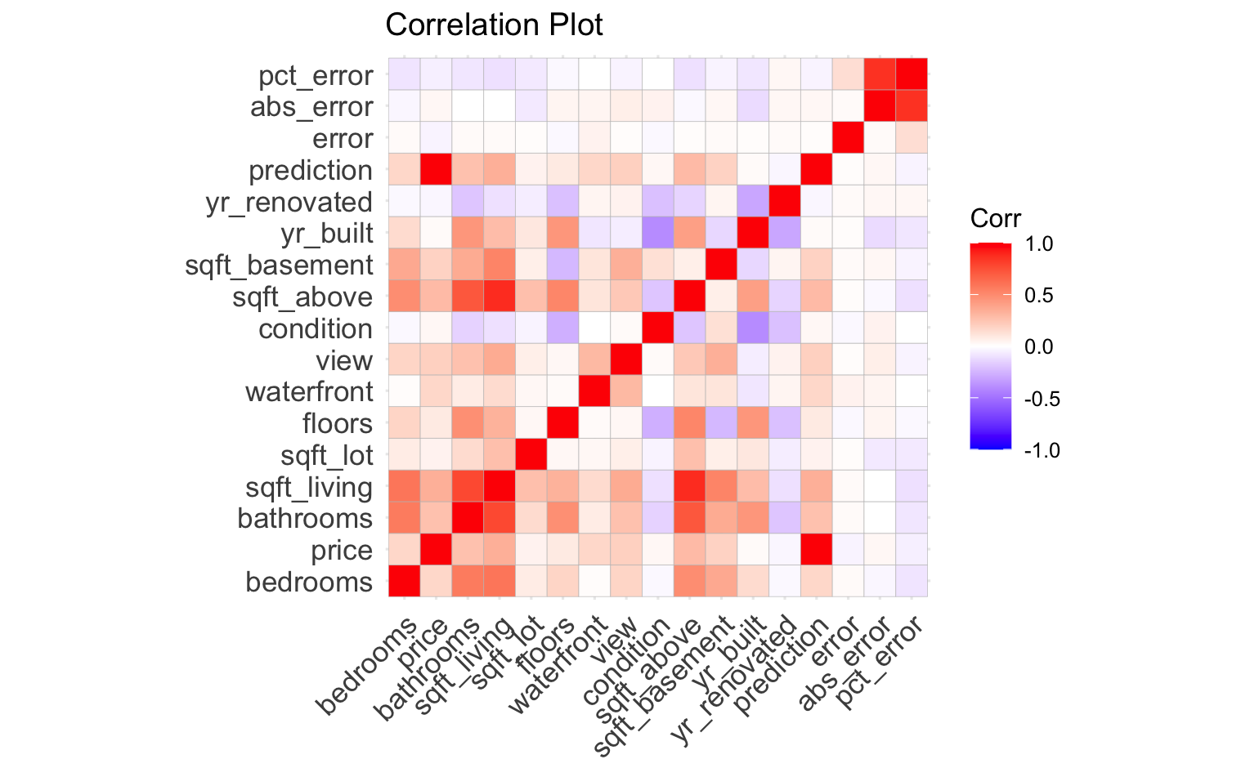
Methods
Modeling Pyspark Machine Learning:
GLM - Linear Regression
70/30 training and testing split
Metrics are R^2 and RMSE

Slide 10
Results
R2 = 0.9975
Goodness of fit
Strong relationship between model and price
RMSE = $40,819.09
Concentration of data around the best fit line
High Results justify only linear regression
More complex models would overfit
Other training would require computational time and is costly

Slide 11
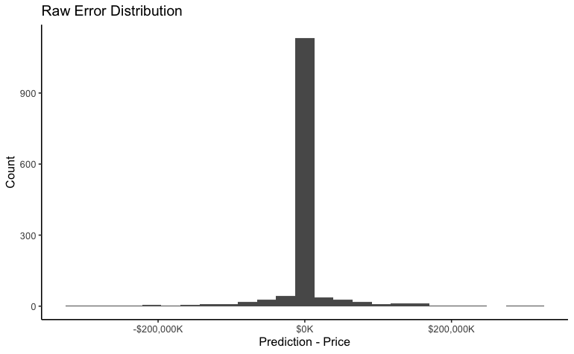
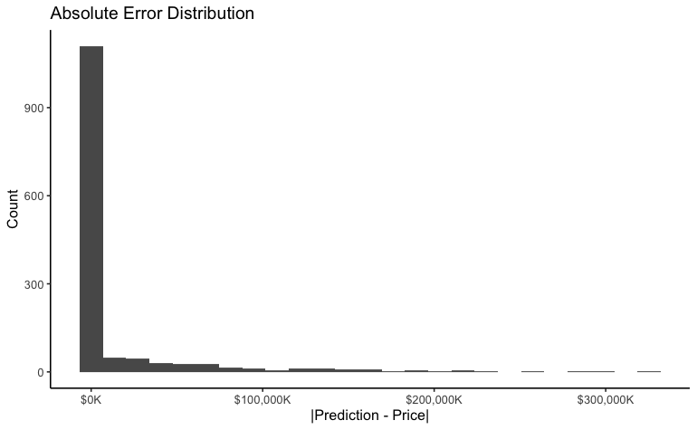
Results
 | Raw Error | Absolute Error
Mean | $435.80 | $13,963.70
Median | -$2.60 | $234.40

Slide 12
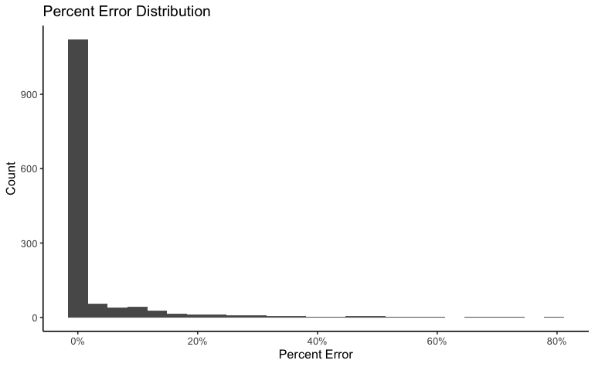
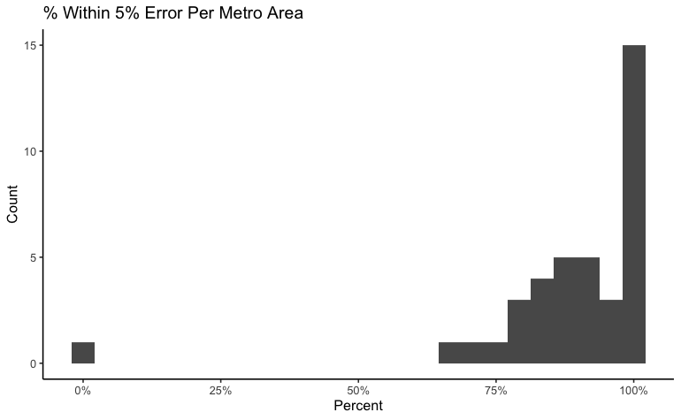
Results
90% of predictions within $5,000 of the actual price
85.5% of predictions within 5% of the actual price

Slide 13
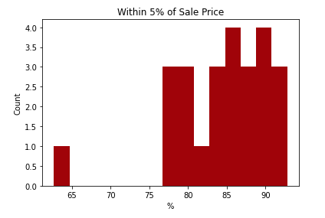
 | Median Error | Within 5% of Sale Price
Zillow | 6.4% | 41.6%
Group 4 Model | 0.05% | 85.5%

Slide 14
Conclusions
Better performance than Zillow with on market assets
Expand out to other metro areas
Using PySpark should allow the model to be robust for scaling to additional data
Likely run into Zillow’s issue with making poor predictions after bargaining and final price is decided

Slide 15
Thank You

